Slide 1

Musica Youth Orchestra
Ancestors who fought in
The Battle of The Somme

Slide 2

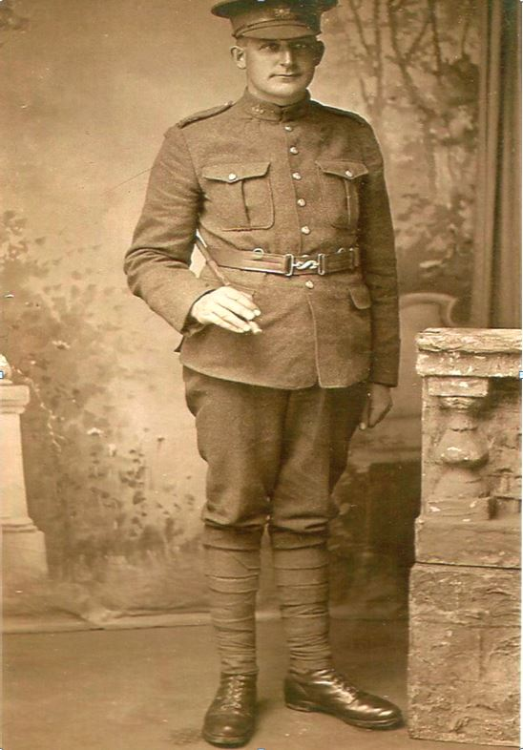
Robert Waterfield Abbott was a private in the 28th Battalion of the Canadian Infantry
Robert Waterfield Abbott, was killed on the first day of the Battle of Flers-Courcelette on 15 September 1916

Slide 3
Flers-Courcelette was the first time that tanks were used in battle
Robert Waterfield Abbott was the great-great-great- uncle of Emily (violin) and Holly (trumpet) Baker

Slide 4
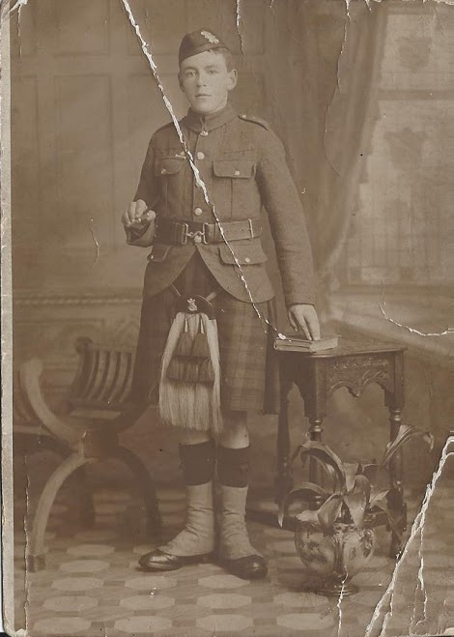
William McAra was in the Black Watch Regiment
In 1914 he tried to join up while he was underage. This photo dates from 1915 before he went to the Battle of the Somme
The first time William McAra fought, he was gassed and returned home to recuperate

Slide 5
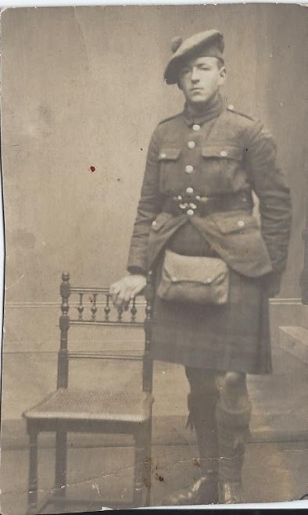
William McAra returned to war and was gassed and shot and had shrapnel wounds in his head yet still survived
The right hand photo is him in 1918 before the war had ended later that year
He received a Victory Medal and a British War Medal
He was the great-great-grandfather of Isabella Rothwell (violin)

Slide 6
The Young Leeds Pals

Slide 7
Most of the Leeds Pals, along with the hundreds of other ‘pals’ regiments formed up and down the country, perished on the same day in the same hour on the first day of the Battle of the Somme

Slide 8
On July 1 1916, the young , so young, men of Leeds: the factory workers, the bootmakers, the bus drivers, the carpenters launched themselves out of stinking wet trenches and ran at the enemy

Slide 9
The young Leeds men were not so much beaten as wiped out
At 7.20am with fearful, pounding hearts, they began to run blindly at their enemy
By 7.30am a city of mothers had lost their sons, wives were widows and children fatherless

Slide 10
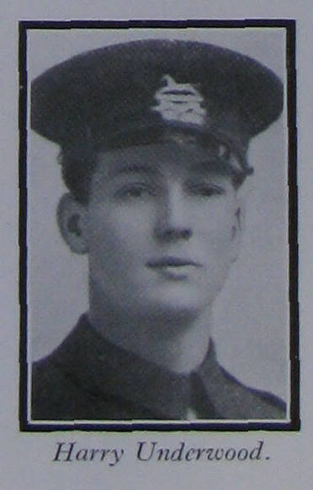
Harry Underwood - Survivor
15th (Service) Battalion (1st Leeds known as the Leeds Pals)
Underwood, Harry Discharged 26/03/19
great-grandfather of Lucas Cieciala (Cello)

Slide 11
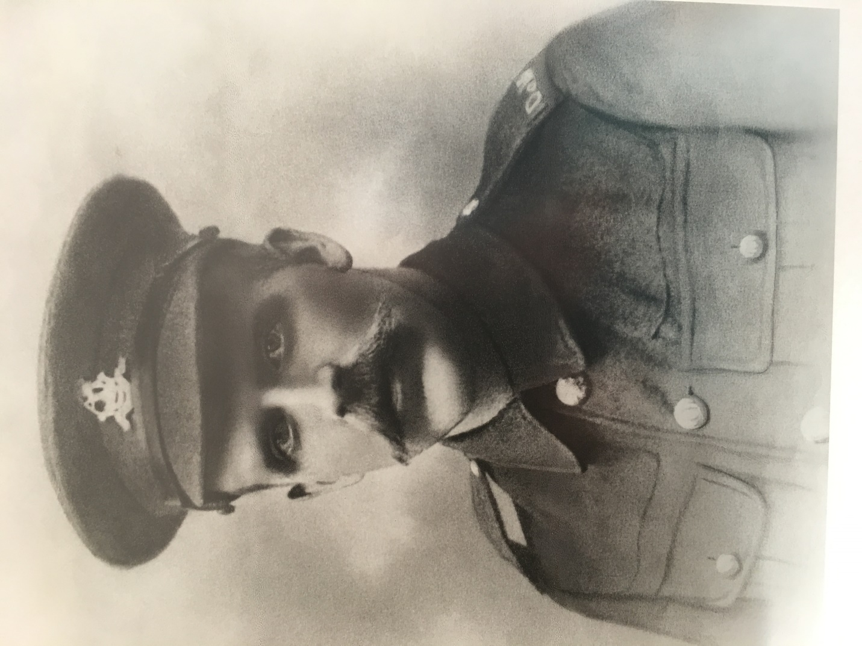
Ralph Stobart – 9th Duke of Wellington’s (West Riding) Regiment
His Service Records were destroyed by enemy action - though his Medal Index Card suggests he enlisted after 1st January 1916

Slide 12
Although his regiment were spared the horrors of 1st July 1916, they were brought to the front line by 7th July 1916
It is thought that Ralph Stobart was wounded by shrapnel on 1st February 1917 and died a few days later
Ralph Stobart was the great-great-grandfather of Harry Stobart (percussion)

Slide 13
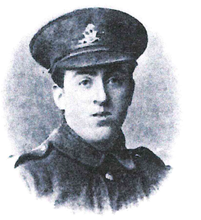
Private Jim Oldroyd – transferred from the West Riding Regiment to 7th Company, Infantry – Machine gun corps on 20th may 1916
He was deployed to France on 24th July 1916 and was killed in action on 24th August 1916 aged 21

Slide 14
Private Oldroyd was awarded the British War Medal and the Victory Medal and is remembered at the Thiepval Memorial, Picardie, France
Private Oldroyd’s descendants still live in Upper Hopton, Mirfield

Slide 15


